Slide 1

Develop and Deploy an Application for Nutrition Assistant
Department of Information Technology
Faculty Mentor – Dr. Sunita Gupta
(Associate Professor)
Team Members: Devanshu Soni – 19ESKIT078
Rishabh Panchal – 19ESKIT302
Ritwik Sharma – 19ESKIT301
Rititk Chourasiya – 19ESKIT081
Lab Coordinator – Mrs. Sanju Choudhary
(Associate Professor)

Slide 2
Contents
Introduction
Purpose of Project
Existing System
Proposed System
Scope
Requirement specification
Technologies/Platforms Used
Modules
UML Diagram
Output Screens
Conclusion
References

Slide 3
Introduction
This application ensures that people receive the nutrients they need to heal and maintain their health.
Nutrition assistants help dieticians with providing proper nutrition at healthcare facilities.
This nutrition assistant can assess a client's level and choice of activity and make appropriate modifications based on individual needs and goals.
This will determine patients nutritional needs, and assess risk factors. They also ensure proper sterilization of plates and utensils.

Slide 4
Purpose of the Project
Due to the ignorance of healthy food habits, obesity rates are increasing at an alarming speed, reflecting the risks to people’s health. People need to control their daily calorie intake by eating healthier foods, which is the most basic method to avoid obesity.
However, although food packaging comes with nutrition (and calorie) labels, it’s still not very convenient for people to refer to App-based nutrient dashboard systems which can analyze real-time images of a meal and analyze it for nutritional content which can be very handy and improves the dietary habits, and therefore, helps in maintaining a healthy lifestyle.

Slide 5
Existing System
Currently, there is a list of food with their nutritional value and benefits to health.
The process is very easy for the user
As a result, users can see plenty of food items
Users are facing the issue of inaccurate information
Users are confused because they cannot determine the exact need of the body.

Slide 6
Proposed System
In this application, a user can create a free account using an Email ID and Password.
User can upload an image of the food item and the system will generate all the nutritional values of that food image.
It offers a BMI calculator and weight gain/loss calculator, empowering users to track their health and make informed decisions about maintaining a healthy weight.
Apart from that there is a separate assistant panel on this application where the
users can assess and make suggestions to improve his/her their health by chatting
with assistant.

Slide 7
Scope
This project aims at building a web App that automatically estimates food attributes such as ingredients and nutritional value by classifying the input image of food.
We have implemented AI-Driven Food Detection Model for accurate food identification.
This application will be accessible in all web browsers and can be used by any user to check the food attributes.
The main aim of this application is to provide nutritional value in food to live a healthy life.

Slide 8
Requirement Specifications
Software Interface
Client on Intranet
User Interface, Windows OS
Development End
Streamlit, Python, Kaggle DB, Tensorflow Windows (OS)
Hardware Interface
Minimum Requirements :
Client Side
 | Processor | RAM | Disk Space
User Interface | SSE3 Capable Intel Pentium 4 | 4 GB | 10 GB
Server Side
 | Processor | RAM | Disk Space
Kaggle DB | x86 64-bit CPU | 4 GB | 5 GB
Python Model | x86 64-bit CPU | 8 GB | 5 GB (Excluding Data Size)

Slide 9
Recommended requirements:
Communication Interface:
Client (User) on Intranet will be using TCP/IP protocol
Client Side
 | Processor | RAM | Disk Space
User Interface | All Intel or AMD – 2.5 GHZ | 8 MB | 5 GB
Server Side
 | Processor | RAM | Disk Space
Kaggle DB | All Intel or AMD – 2.5 GHZ | 8 GB | 3.5 GB
Python Model | All Intel or AMD – 2.5 GHZ | 8 GB | 5 GB (Excluding Data Size)

Slide 10
Technologies/Platforms Used
Streamlit (version 1.22) – Used for developing interactive user interfaces.
Flask (version 2.3.2) – Used for developing the back-end or server-side programming.
Kaggle DB – Used for developing the database of users.
VS Code (version 1.74)– Used for development operations like debugging, task running, and version control.
Python (version 3.6.4) – Used for developing image recognition of food items.
Tensorflow (version 3.7) – Used for developing AI Model.

Slide 11
Modules
Module 1:- GUI and Database Designing –
Requirement analysis was carried out
An API(Application programming interface) is used to recognize the food item image using Python.
Firebase is used as a database for storing user credentials.
Module 2:- GUI Design and Backend Coding for Nutrition Assistant
Requirement analysis was carried out
Coding for GUI Designing was done using Streamlit.
Coding for assistant and BMI, weight gain calculator is carried out by using Python.

Slide 12
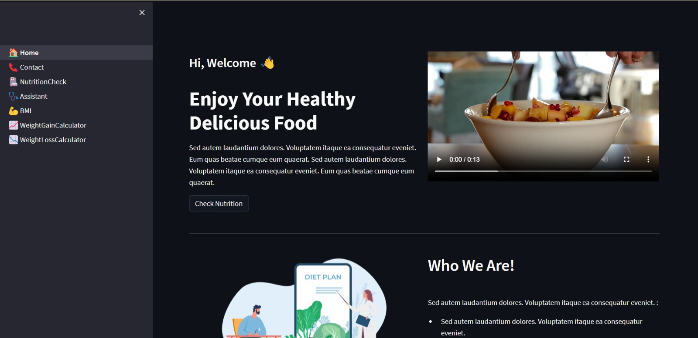
Home Page

Slide 13
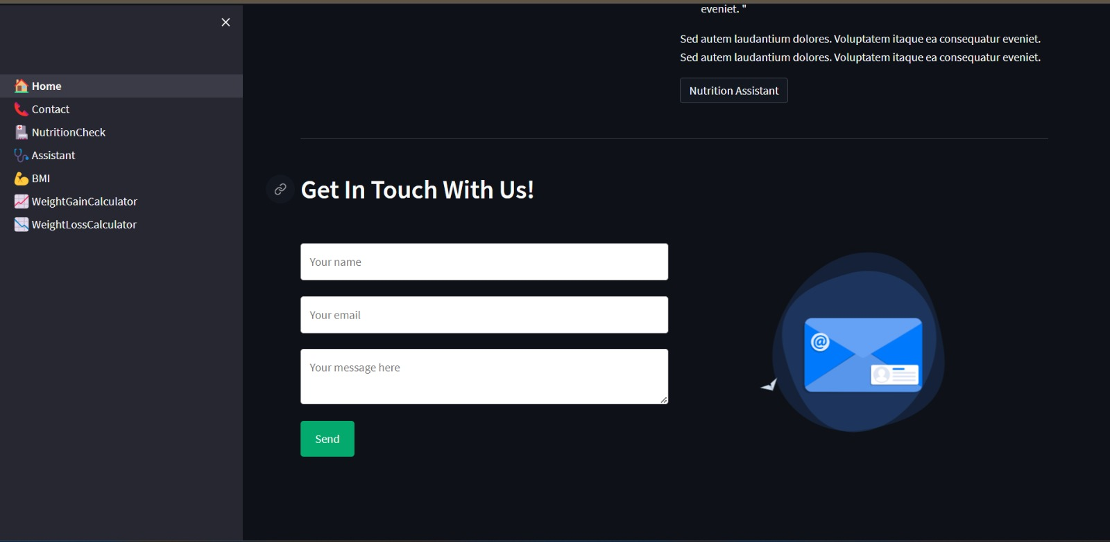
Home Page

Slide 14
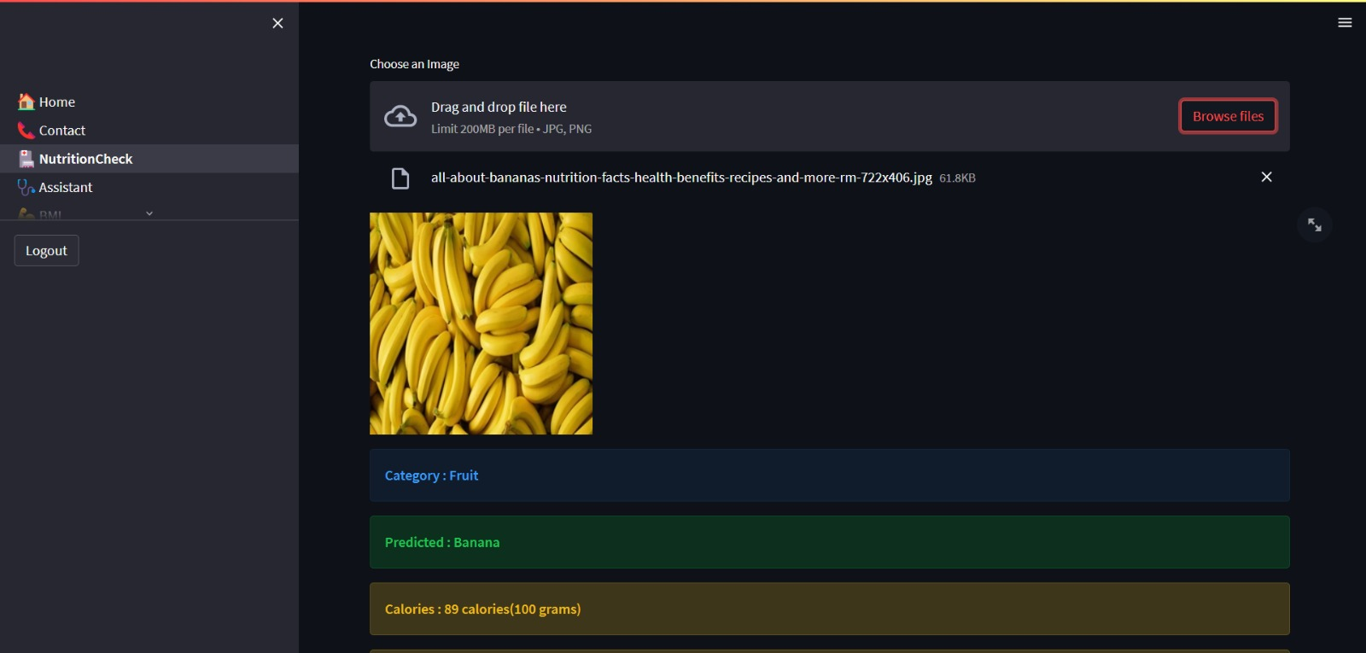
Nutrition Check

Slide 15
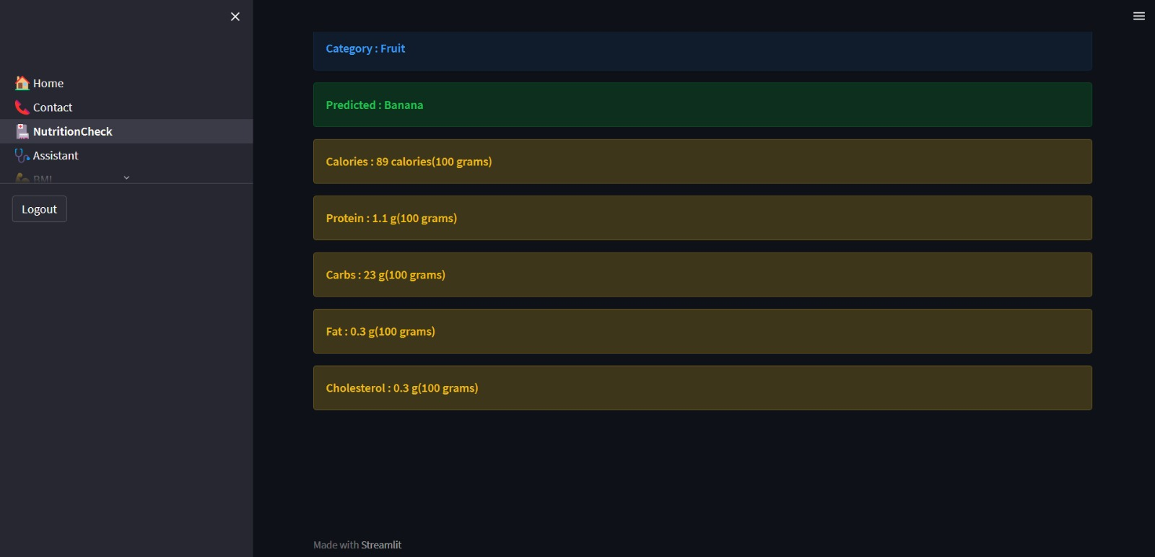
Nutrition Check

Slide 16
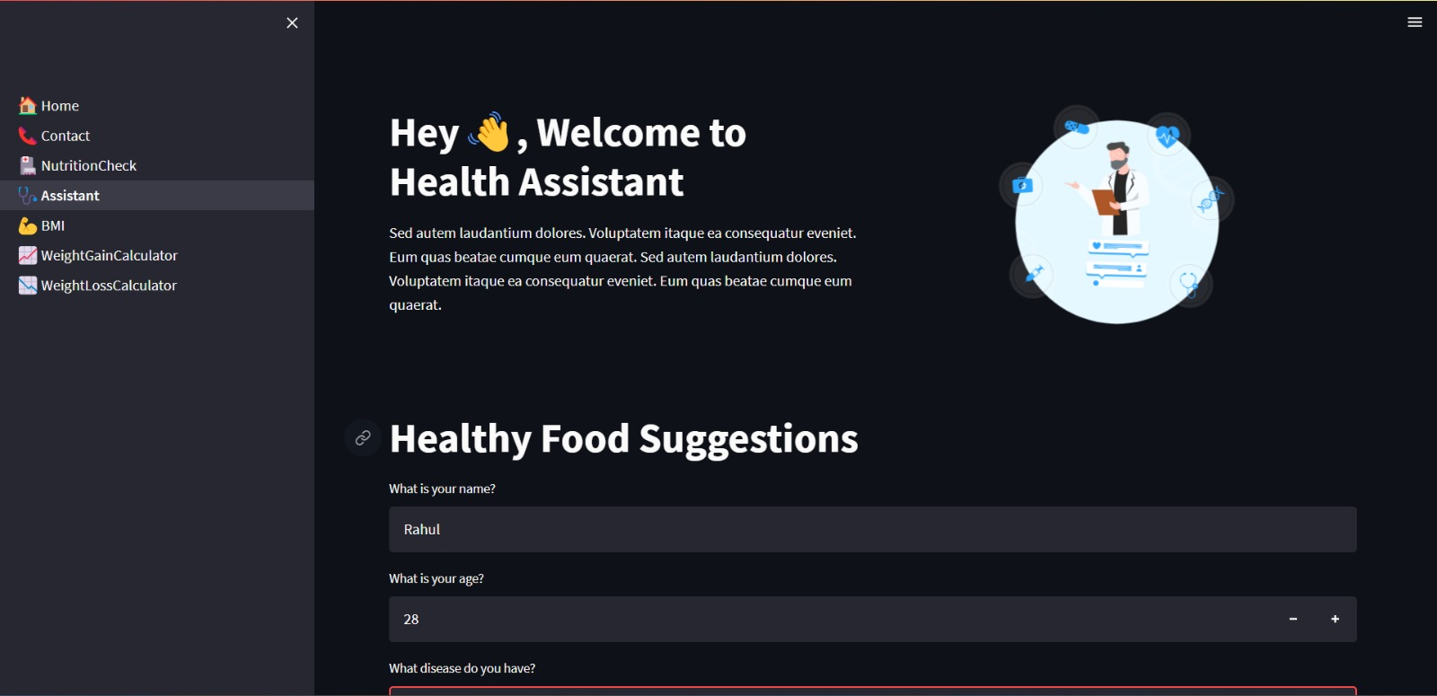
Assistant

Slide 17
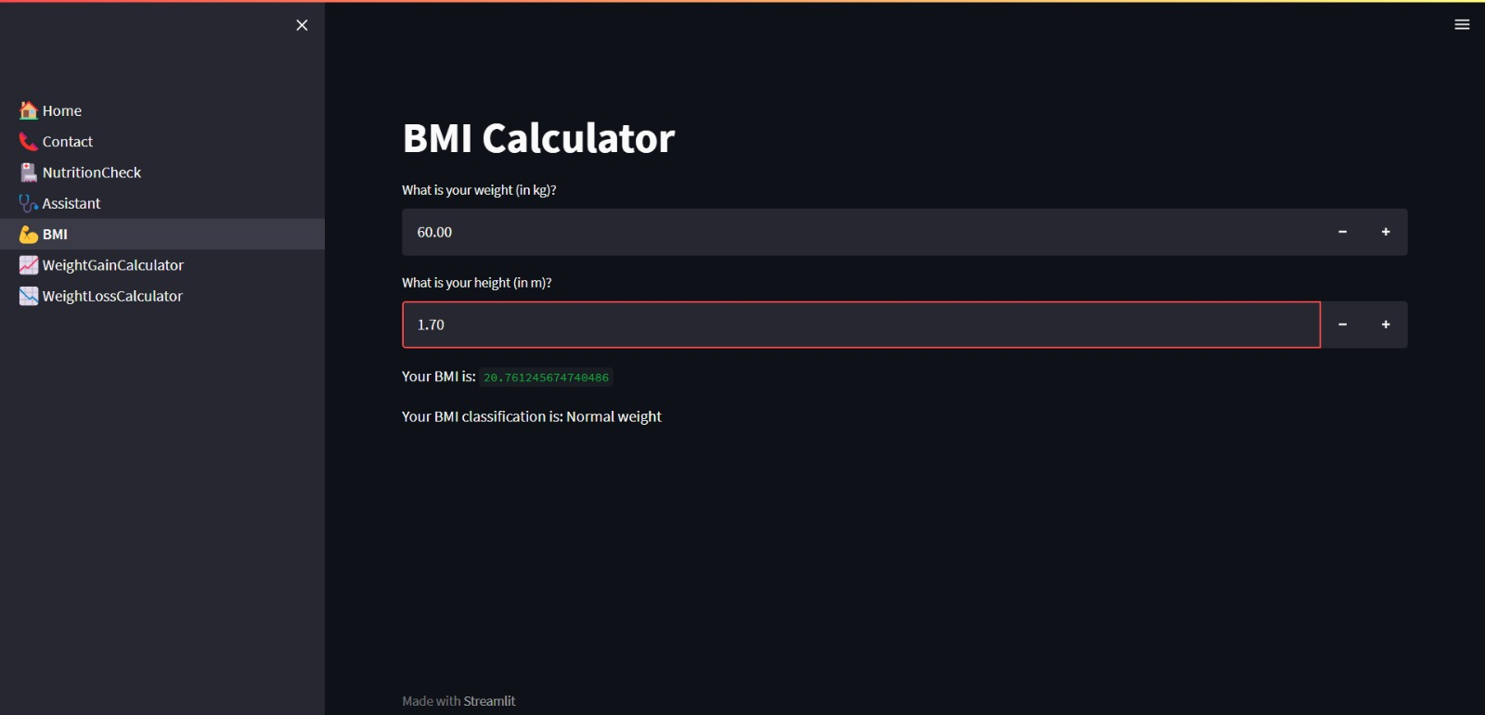
BMI Calculator

Slide 18
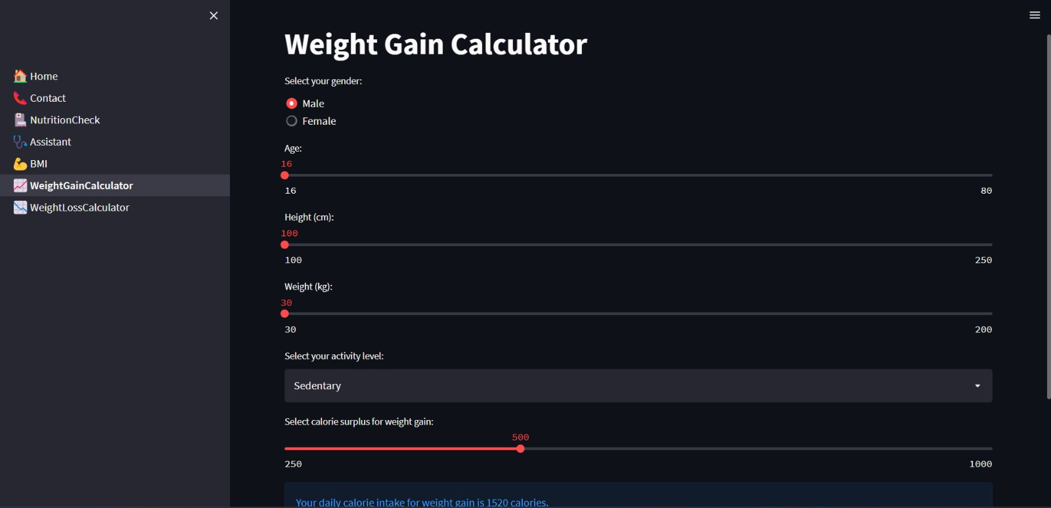
Weight Gain Calculator

Slide 19
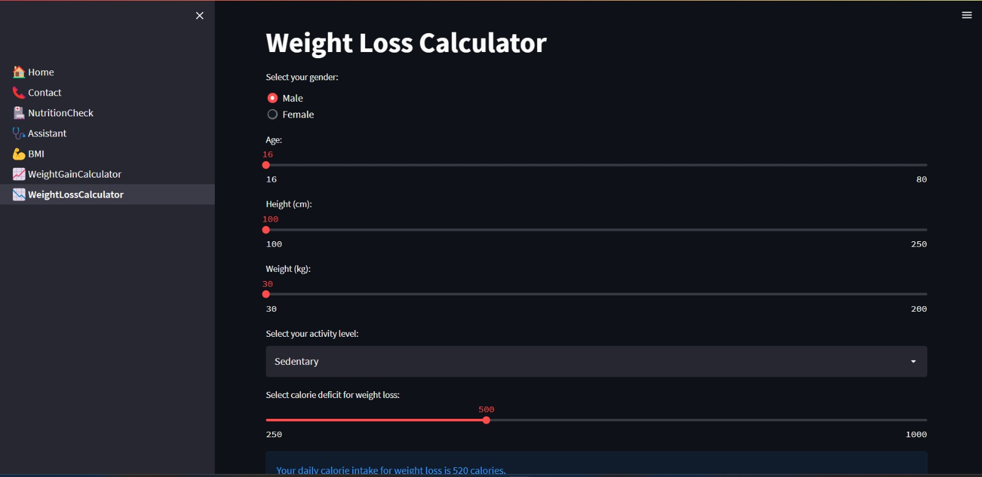
Weight Loss Calculator

Slide 20
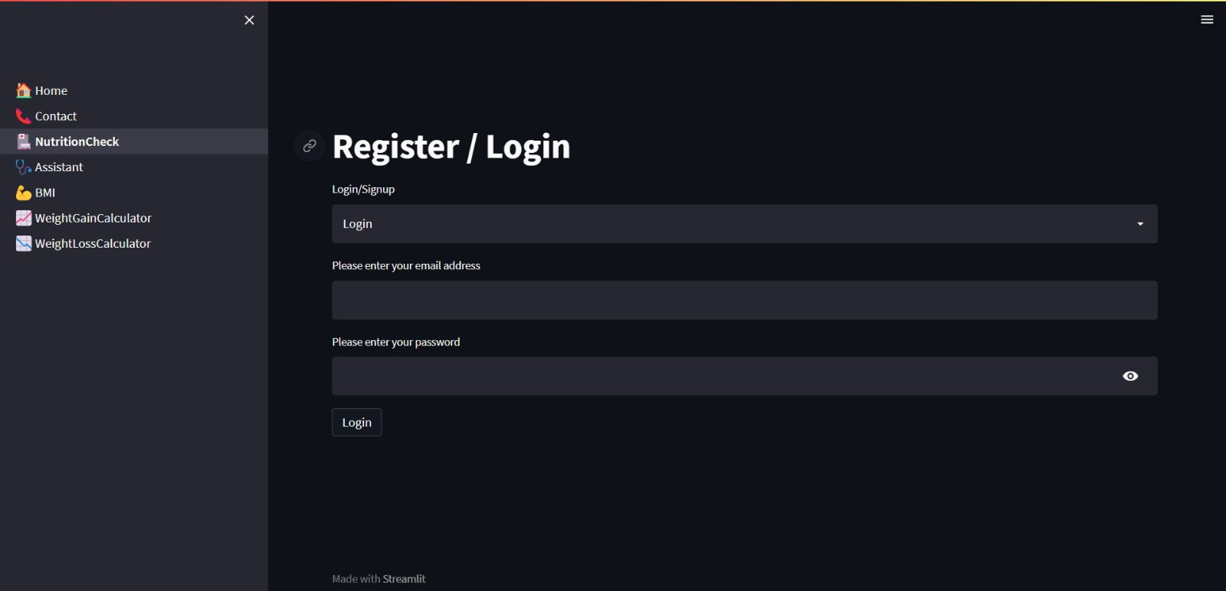
Login Page

Slide 21
Conclusion
Due to the ignorance of healthy food habits, obesity rates are increasing at an alarming speed, and this is reflective of the risks to people’s health.
People need to control their daily calorie intake by eating healthier foods, which is the most basic method to avoid obesity.
This web App can automatically estimate food attributes such as ingredients and nutritional value by classifying the input image of food
This web application utilizes an AI-driven food detection model developed in-house to accurately identify various types of food items.
This application will be accessible in all web browsers and can be used by any user to check the food attributes.

Slide 22
References
•Object Oriented Modeling and Design with UML-Michael Blaha, James Rambaugh.
•Software Engineering, Seventh Edition, Ian Sommerville.
•Wikipedia - https://en.wikipedia.org/wiki/Human_nutrition
•Kaggle DB - https://www.kaggle.com/docs/datasets
•Streamlit- https://docs.streamlit.io/
•Flask - https://flask.palletsprojects.com/en/2.3.x/tutorial/
•Python - https://machine-learning-with-python.readthedocs.io/en/latest/

